Slide 1
Generating the Written Examination Question

Slide 2
Learning Objectives
At the end of the session, you will be able to:
  Understand the purpose of the competency assessment tools
  Describe the steps for generating the written exam questions
  Create a written examination packet

Slide 3
Steps for Generating Written Exam Questions
1. Create set of 25 question codes using the Random Question Generator
2. Transfer the question codes generated to the Question Tracker Sheet
4. Transfer the matching questions to the Written Examination Questions Version and Answer key
3. Select the matching questions from the Question Bank created
5. Print the Written Examination Questions version with the Examination Sheet for each exam to be administered

Slide 4
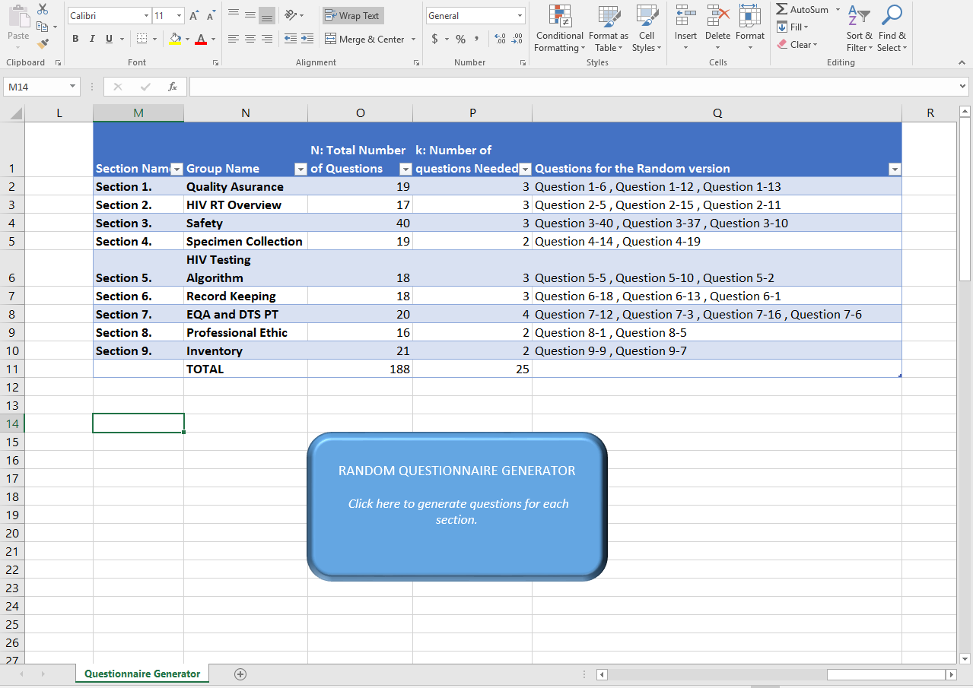
Step 1. Create 25 question codes using the Random Question Generator

Slide 5
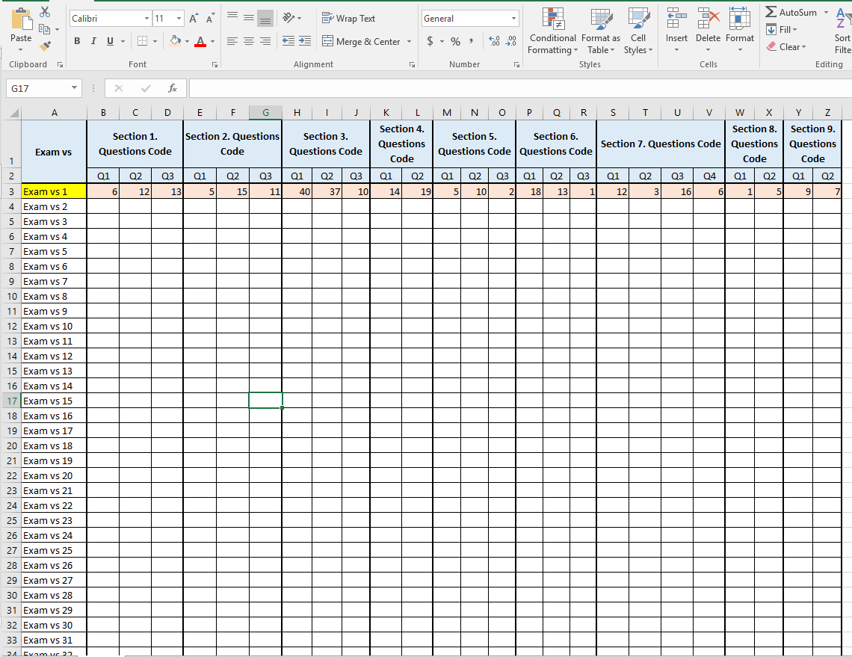
Step 2. Transfer the question codes to the Question Tracker Sheet

Slide 6
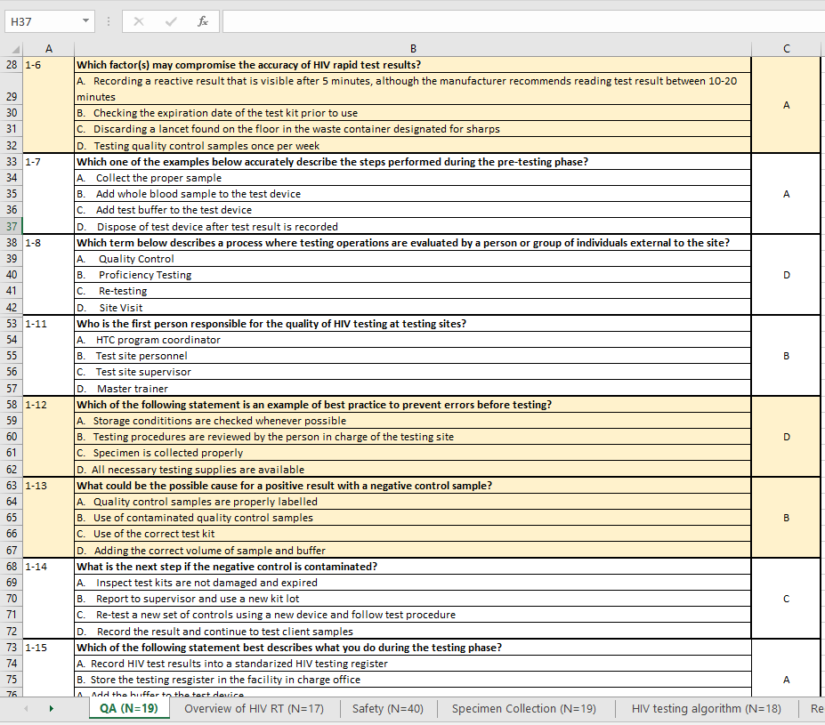
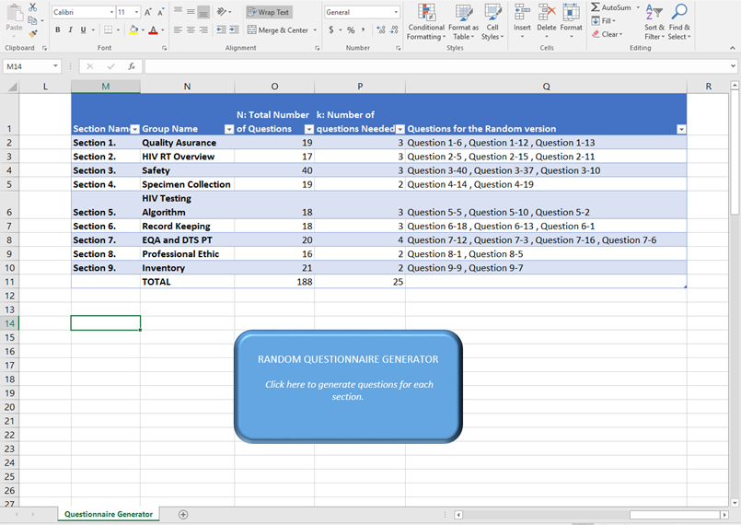
Step 3. Select the matching questions from the Question Bank

Slide 7
Step 4. Transfer Matching Questions to the Written Examination Question Template

Slide 8
Step 5. Creating Written Examination Packet for Evaluator
Registration sheet
Written Examination Question Version
Written Examination Question Version with answer key
Written Examination Sheet

Slide 9
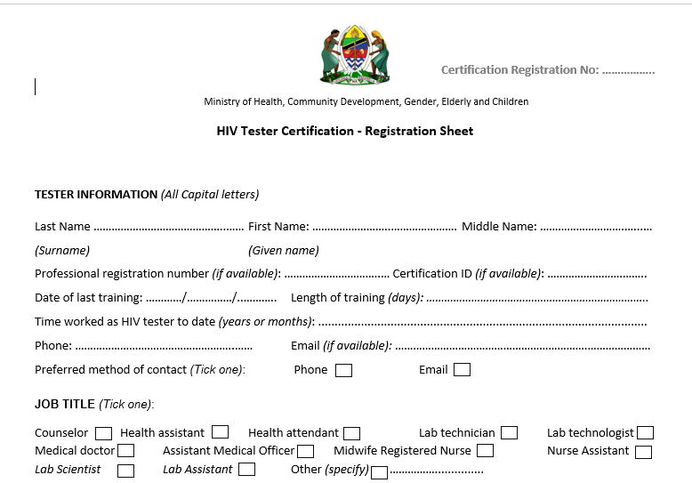
1. Registration Sheet (1)

Slide 10
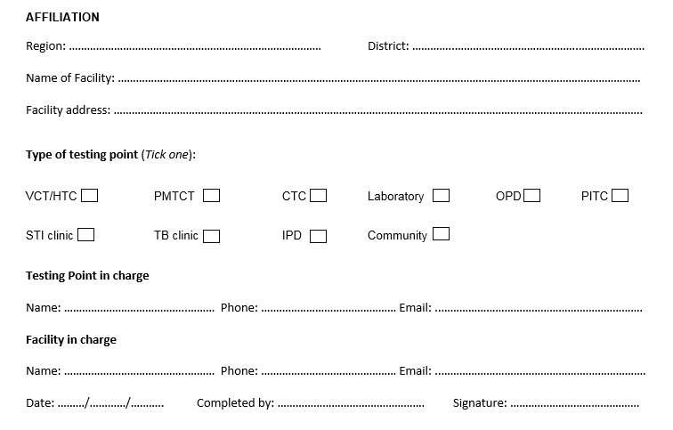
1. Registration Sheet (2)

Slide 11

2. Written Examination Question version

Slide 12
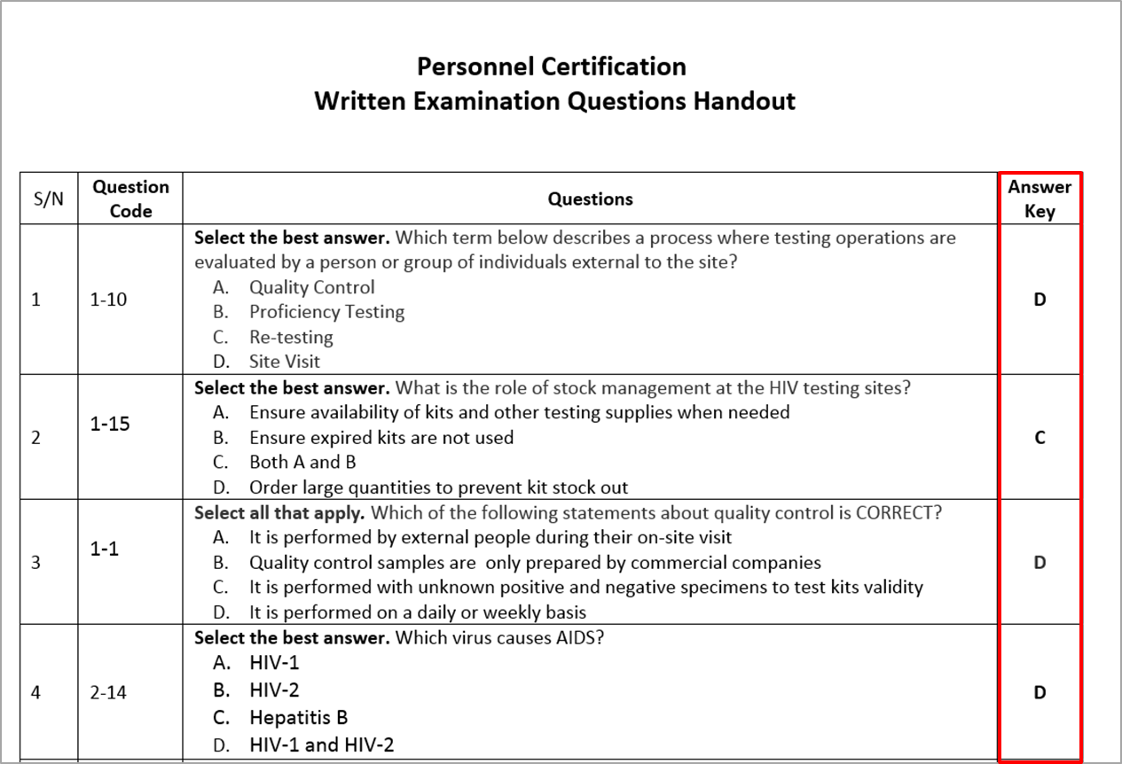
3. Written Examination Questions with Answer Key for Evaluator

Slide 13
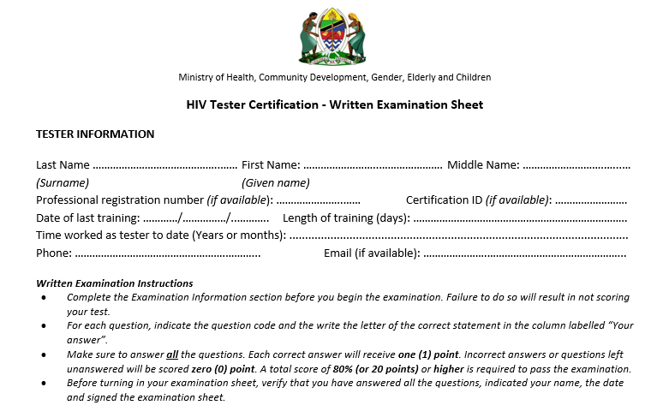
Written Examination Sheet (1)

Slide 14

Tester Completing the Written Examination Sheet (2)

Slide 15
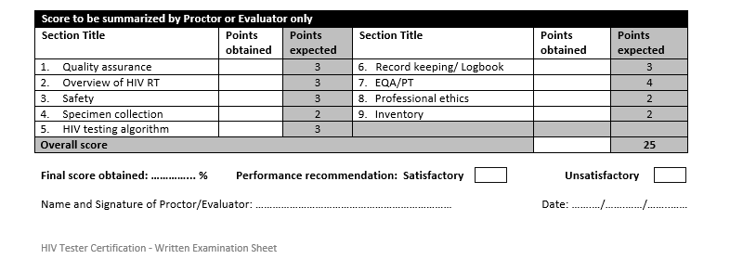
Evaluator Completing the Written Examination Sheet (3)

Slide 16
Summary
What is the purpose of the written competency assessment tools?
What are the steps for generating written exam questions?
What constitute the written examination packet?

